Slide 1
Dataweave
Abdul Hannan
2, 2020

Slide 2
To understand
Dataweave Operation
Dataweave Functions
Dataweave Flow Control

Slide 3
DataWeave Operators
DataWeave 2.0 supports several
mathematical
equality
relational
logical
prepend
append operators

Slide 4
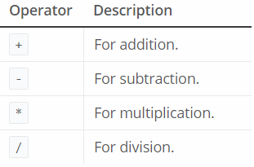
Mathematical Operation:

Slide 5
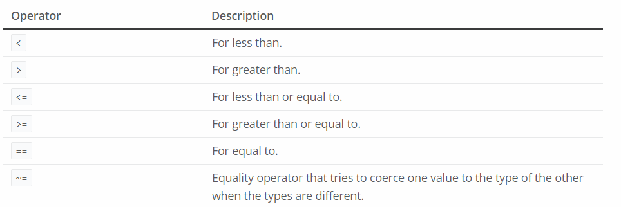
Equality and Relational Operators

Slide 6
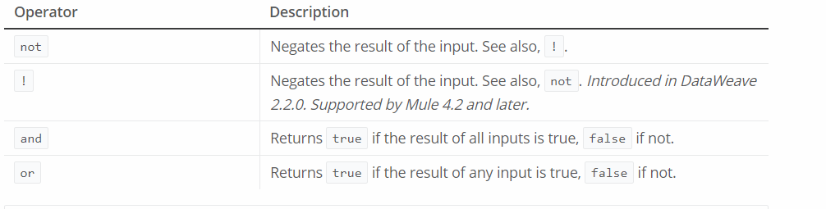
Logical Operators

Slide 7
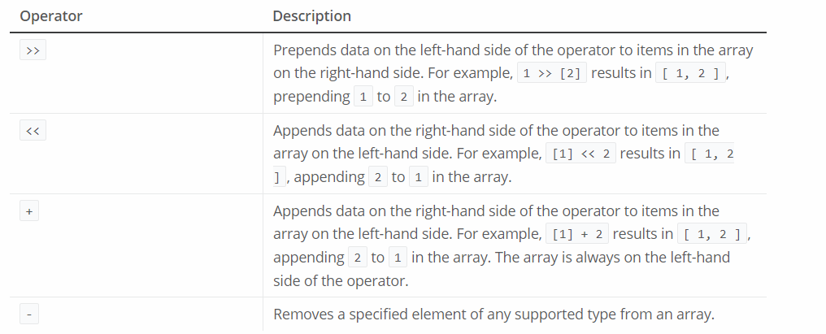
Prepend, Append, and Remove Operators for Arrays

Slide 8
Dataweave Import
To use some modules, you need to import the module or functions you want to use by adding the import directive to the head of your DataWeave script.
import dw::core::Strings
import camelize, capitalize from dw::core::Strings
import * from dw::core::Strings

Slide 9
Dataweave Functions
We can define our own DataWeave functions using the fun declaration in the header of a DataWeave script. Functions in the Core (dw::Core) module are imported automatically into your DataWeave scripts. In other word no need to import functions like other module.
%dw2.0
output application/json
fun toUpper(aString) = upper(aString)
---
toUpper("hello")
The above script will print HELLO

Slide 10
Flow Control in DataWeave
do: A do statement creates a scope in which new variables, functions, annotations, or namespaces can be declared and used. The syntax is similar to a mapping in that it is composed of a header and body separated by ---. Its header is where all the declarations are defined, and its body is the result of the expression.
%dw 2.0
output application/json
fun myfun() = do
{
var name = "DataWeave Tutorial “
---
name
}
---
{
result: myfun()
}
The above script will print: { "result": "DataWeave" }

Slide 11
if else: an if statement evaluates a conditional expression and returns the value under the if only if the conditional expression is true. Otherwise, it will return the expression under else every if expression must have a matching else expression.
%dw 2.0
output application/json
---
if (payload.country == "USA")
{
currency: "USD"
}
else {
currency: "EUR"
}

Slide 12
else if: You can chain several else expressions together within an if-else construct by incorporating else if .
%dw 2.0
output application/json
---
if (payload.country =="USA")
{ currency: "USD" }
else if (payload.country =="UK")
{ currency: "GBP" }
else { currency: "EUR" }

Slide 13
https://docs.mulesoft.com/mule-runtime/4.2/dataweave
https://dzone.com/articles/introduction-to-dataweave

